Slide 1
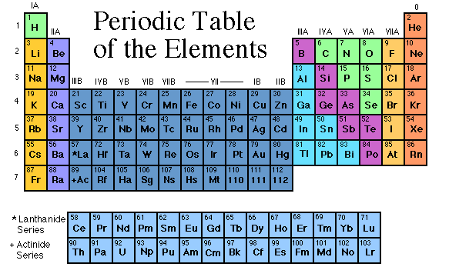
Chemistry

Slide 2
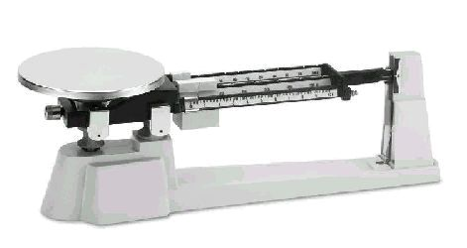
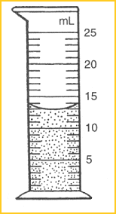
Matter
Matter = any material substance with Mass & Volume

Slide 3
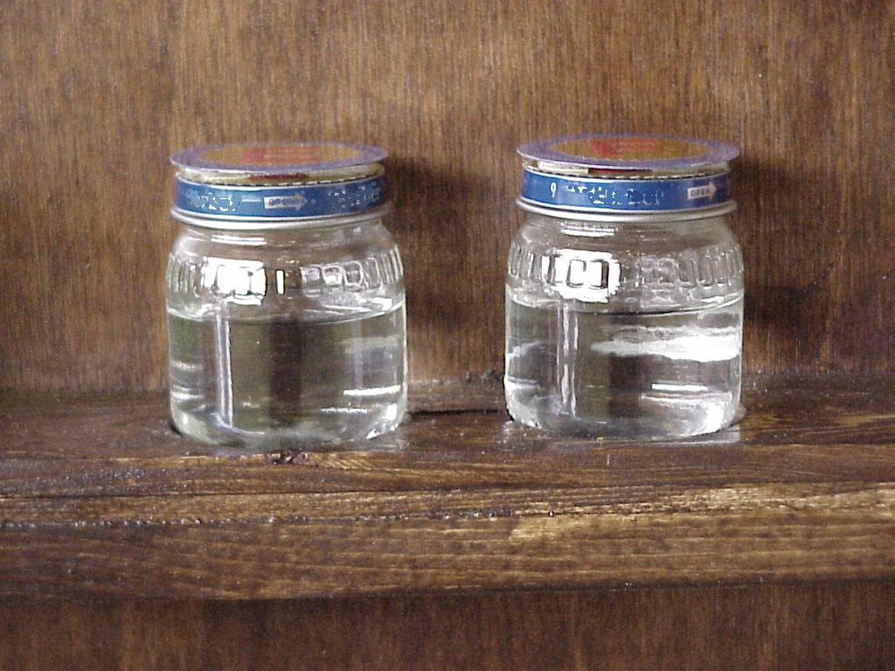

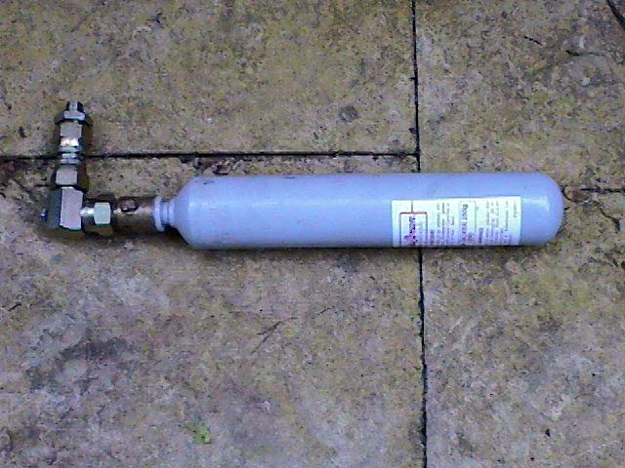
Matter
comes in 3 phases
Solid
Gas
Liquid

Slide 4
Solid
Definite Shape
Definite Volume

Slide 5
Liquid
Indefinite Shape – takes the shape of the container
Definite Volume

Slide 6
Gas
Indefinite Shape – takes the shape of the container
Indefinite Volume – can expand and be compressed

Slide 7
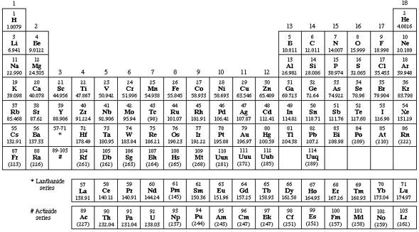
Elements
one of the 100+ pure substances
that make up everything in the universe

Slide 8
Examples of Elements
C
= Carbon
Na
= Sodium
O
= Oxygen
Ca
= Calcium
H
= Hydrogen
K
= Potassium
I
= Iodine
N
= Nitrogen
S
= Sulfur
Cl
= Chlorine
P
= Phosphorus

Slide 9
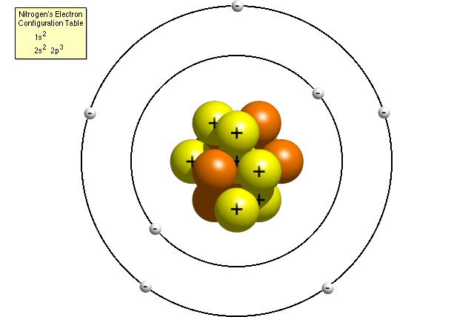
Atom
the smallest particle making up elements

Slide 10
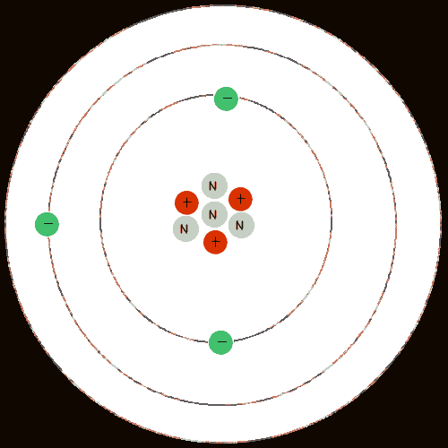
Sub-atomic Particles
Protons p⁺ - positive charge, in nucleus
Neutrons n⁰ – no charge, in nucleus
Electrons - e⁻ negative charge, orbiting nucleus

Slide 11
Drawing an Atom of Carbon
6
Atomic #
= # of p⁺ and # of e⁻
C
12.011
Carbon has 6 p⁺ and 6 e⁻
Atomic Mass
minus Atomic # = # of n⁰
Carbon has 6 n⁰

Slide 12
Drawing an Atom of Carbon
e⁻
e⁻
6 p⁺
e⁻
e⁻
6 n⁰
e⁻
e⁻

Slide 13
Compounds
Compounds - 2 or more elements chemically combined to form a new substance with new properties
Properties – The way a chemical substance looks and behaves

Slide 14
Compounds
Compounds – are made of 2 or more different atoms combined to form Molecules
O
H + O H₂O =
H
H
Chemical formula lists the number of different atoms in a single molecule
Structural formula shows the arrangement of the atoms in a single molecule

Slide 15
Molecules
Glucose Sugar
H
H
C
O
H
C₆H₁₂O₆
C
O
H
H
H
C
H
C
O
H
O
H
O
H
C
C
Chemical formula
H
O
H
Structural formula

Slide 16
Compounds
Inorganic Compounds
Organic Compounds
or
usually don’t contain Carbon
generally come from the earth
generally simple molecules
always contain C & H and usually O, N, sometimes S & P
originate in organisms
generally complex molecules

Slide 17
Examples of Inorganic Compounds
H + O
= H₂O = Water
H + Cl
= HCl = Hydrochloric Acid
C + O
= CO₂ = Carbon Dioxide
Na + Cl
= NaCl = Common Table Salt

Slide 18
Examples of Organic Compounds
C, H + O
Carbohydrates = Sugars, starches & cellulose
C, H + O
Lipids = Fats & Oils
C, H, O, N, & sometimes P + S
Proteins
C, H, O, N, + P
Nucleic Acids – DNA & RNA

Slide 19

Chemistry
Diga, diga, diga, diga, that’s all folks!

Slide 20
This powerpoint was kindly donated to www.worldofteaching.com
http://www.worldofteaching.com is home to over a thousand powerpoints submitted by teachers. This is a completely free site and requires no registration. Please visit and I hope it will help in your teaching.

